Slide 1



Toronto Police Service Final Report “The work we submitted as part of this assignment is original, and due credit is given to others where appropriate. We accept and acknowledge that each team member is equally responsible if the assignment is found to be plagiarized in any way. We will be subject to the school’s Academic Integrity policy.”
Masters of Business Analytics ‘24
Group 10
Aimal Dastagirzada – 220088928
Chengjie Lou - 217648502
Kenji Niyokindi - 220827994
Mahin Bindra – 220089330
Yucheng Wang - 220166328

Slide 2
Agenda
Key Research Objectives
Executive Summary
Introduction
Analysis and Modelling
Recommendations and conclusions
Next Steps

Slide 3


Key Research Objectives
Improve safety and economic conditions of civilians across neighborhoods in Toronto by assessing proportion of crime rate (firearm shootings) by area, re-allocating resources by predicting future occurrences
Which areas or neighborhoods within Toronto experience the highest and lowest firearm-related violent crime?
What are the various trends and consistencies within each of these neighborhoods? What, in specific, is driving these trends?
What factors, if any, such as unemployment or lack of education contribute to such crimes?
What strategies we can devise to assess the location and occurrence of future crimes and recommend solutions to avoid them?

Slide 4
Agenda
Key Research Objectives
Executive Summary
Introduction
Analysis and Modelling
Recommendations and conclusions
Next Steps

Slide 5




Executive Summary
Toronto Police Service (TPS) is the city's law enforcement agency with 7,600 uniformed and civilian members. It comprises 17 police divisions and handles various safety and law enforcement responsibilities
The purpose of this project is to devise predictive models for the Toronto Police Services (TPS) to prognosticate potential shooting related crime occurrences based on neighborhoods and assess impact of external factors such as education and employment rates
Our analysis consisted of performing data cleaning practices and exploratory analysis to assess high and low crime areas and which variables impact those statistics
Post that we built a KNN-regression model to forecast location of potential criminal incidents; our model demonstrated exceptionally impressive R-squared values - of 0.93 and 0.84 - in predicting latitude and longitude values respectively for neighborhoods with high crime rate
Based on the built predictive models and the analysis conducted, our strategic recommendations for the Toronto police consists of a three-pronged approach: re-organize, re-allocate, and re-invest the available resources to effectively curb the increase in crime rates and enhance overall public safety to potentially reduce crime rates across neighborhoods and build a safer society for citizens

Slide 6
Agenda
Key Research Objectives
Executive Summary
Introduction
Analysis and Modelling
Recommendations and conclusions
Next Steps

Slide 7





With the advent of firearm shooting-related crimes in Toronto, there exists opportunity to devise strategies which can potentially assist the police to reduce such incidents
SOLUTION
We implemented a KNN regression model to assist the Toronto police in identifying potential crime occurrences and their location and suggest possible solutions to avoid such heinous crimes
CHALLENGE
Several neighborhoods in Toronto experience a notable increase in crime rates, which raises concerns among the community and the law enforcement
ANALYSIS
A dataset containing information regarding firearm shooting related crime was provided to us, which was used for analysis and synthesis

Slide 8
Agenda
Key Research Objectives
Executive Summary
Introduction
Analysis and Modelling
Recommendations and conclusions
Next Steps

Slide 9




Initially, the dataset provided contained some erroneous values, hence taking a system approach to clean the data was essential
Identified and removed NSA values from the neighborhood and Latitude / longitude column to avoid difficulties in interpretation
Assessed number of crimes per neighborhood to evaluate trends and decide modelling approach
Data Cleaning Approach
Recognized high crime and low crime neighborhoods across years using trend lines and percentile benchmarks
Finally, assessed any fluctuations within high and low crime neighborhoods..

Slide 10
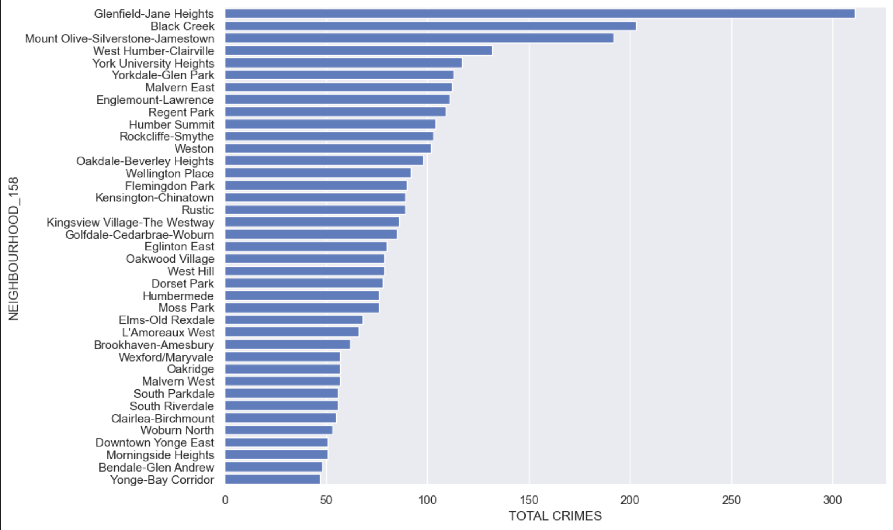
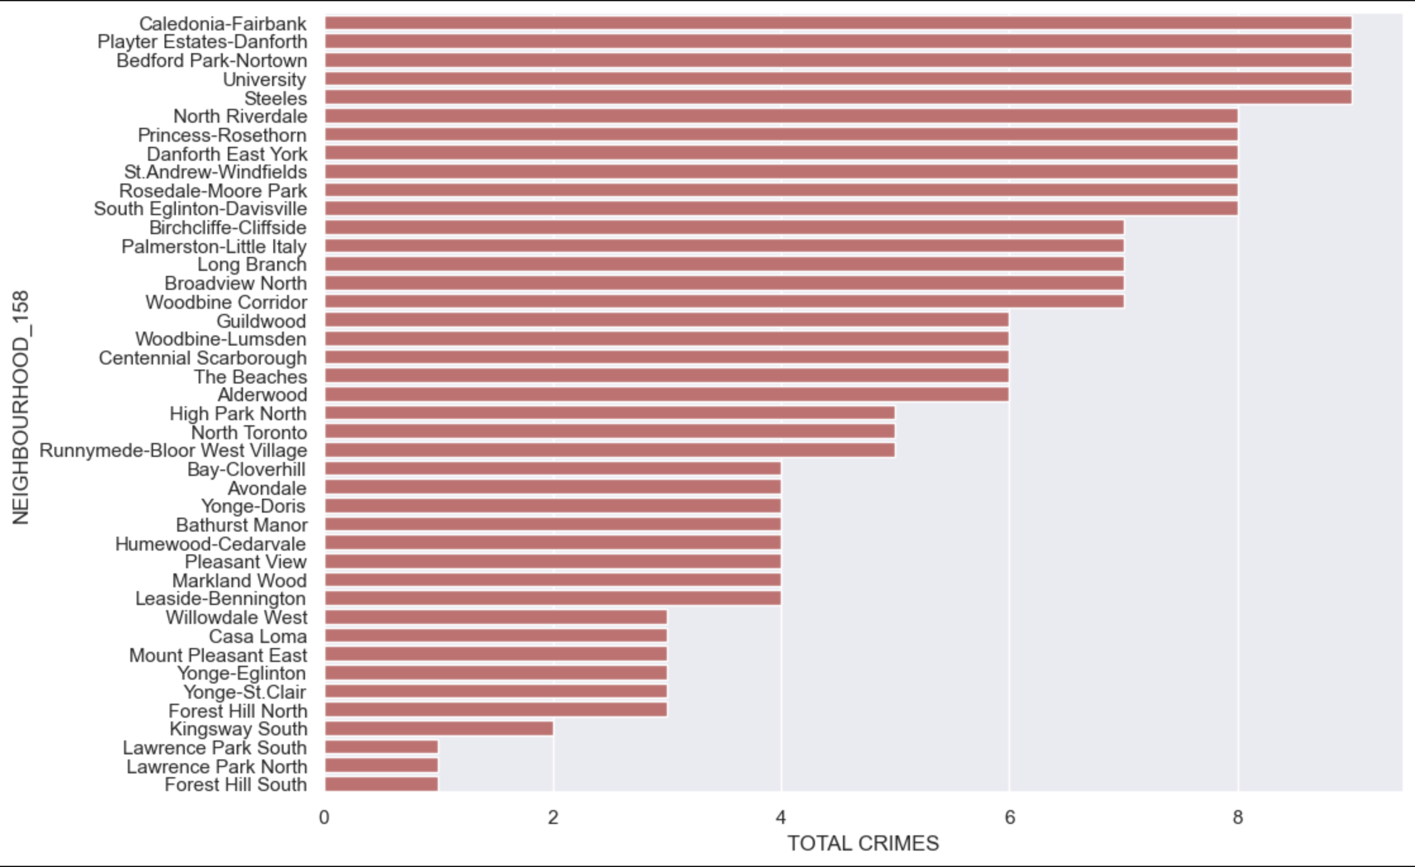
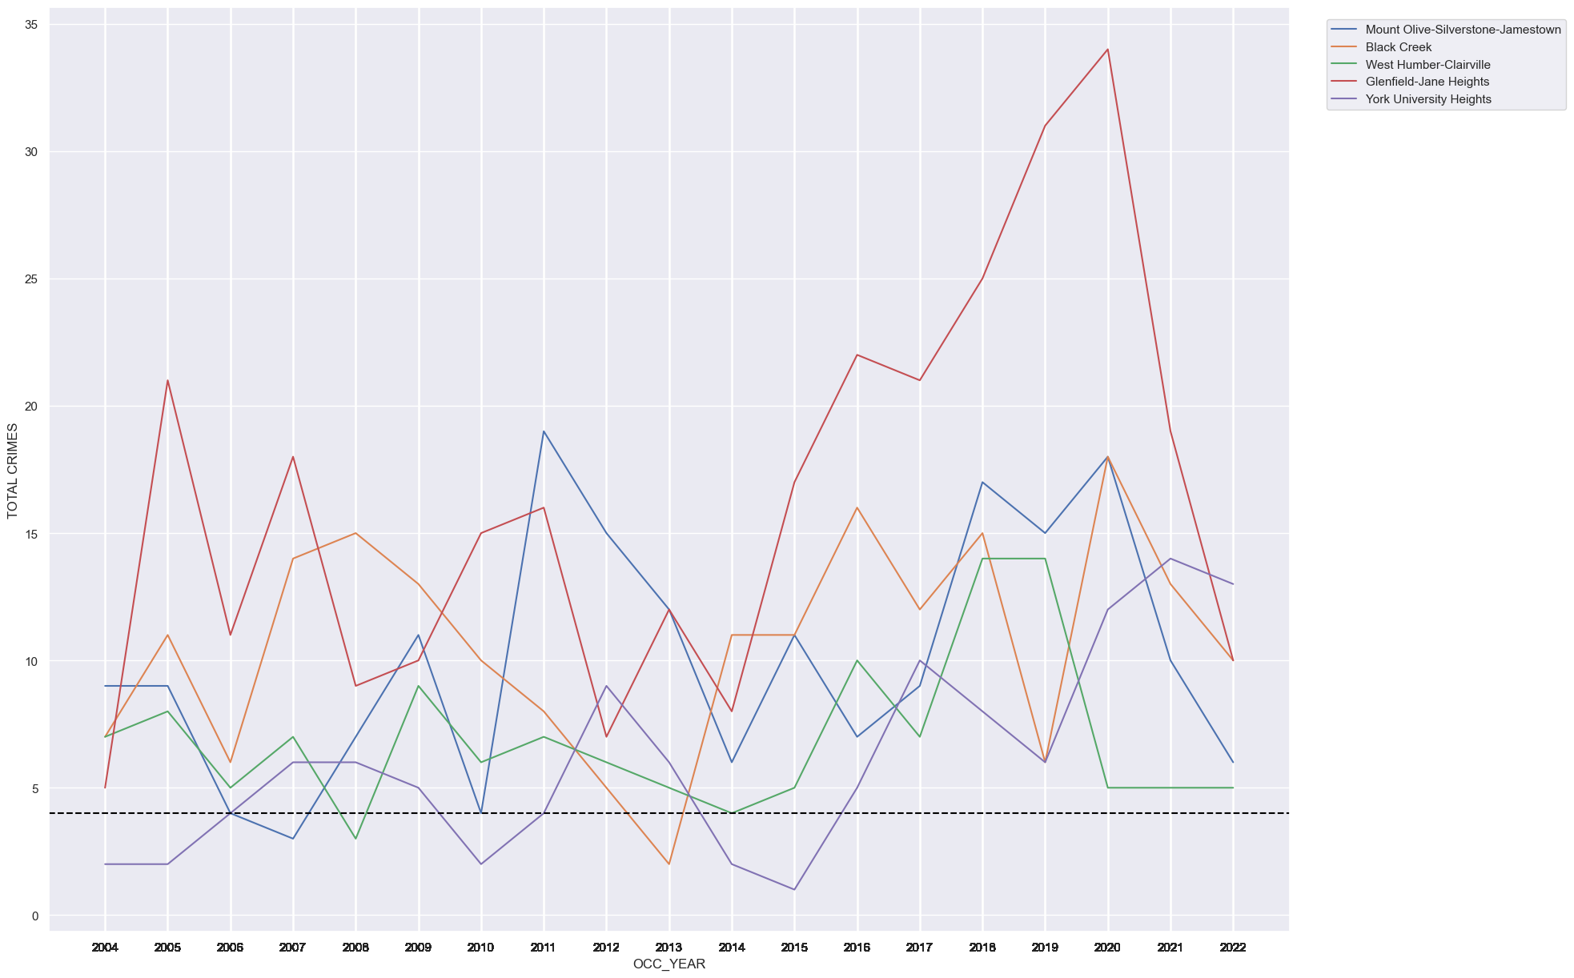
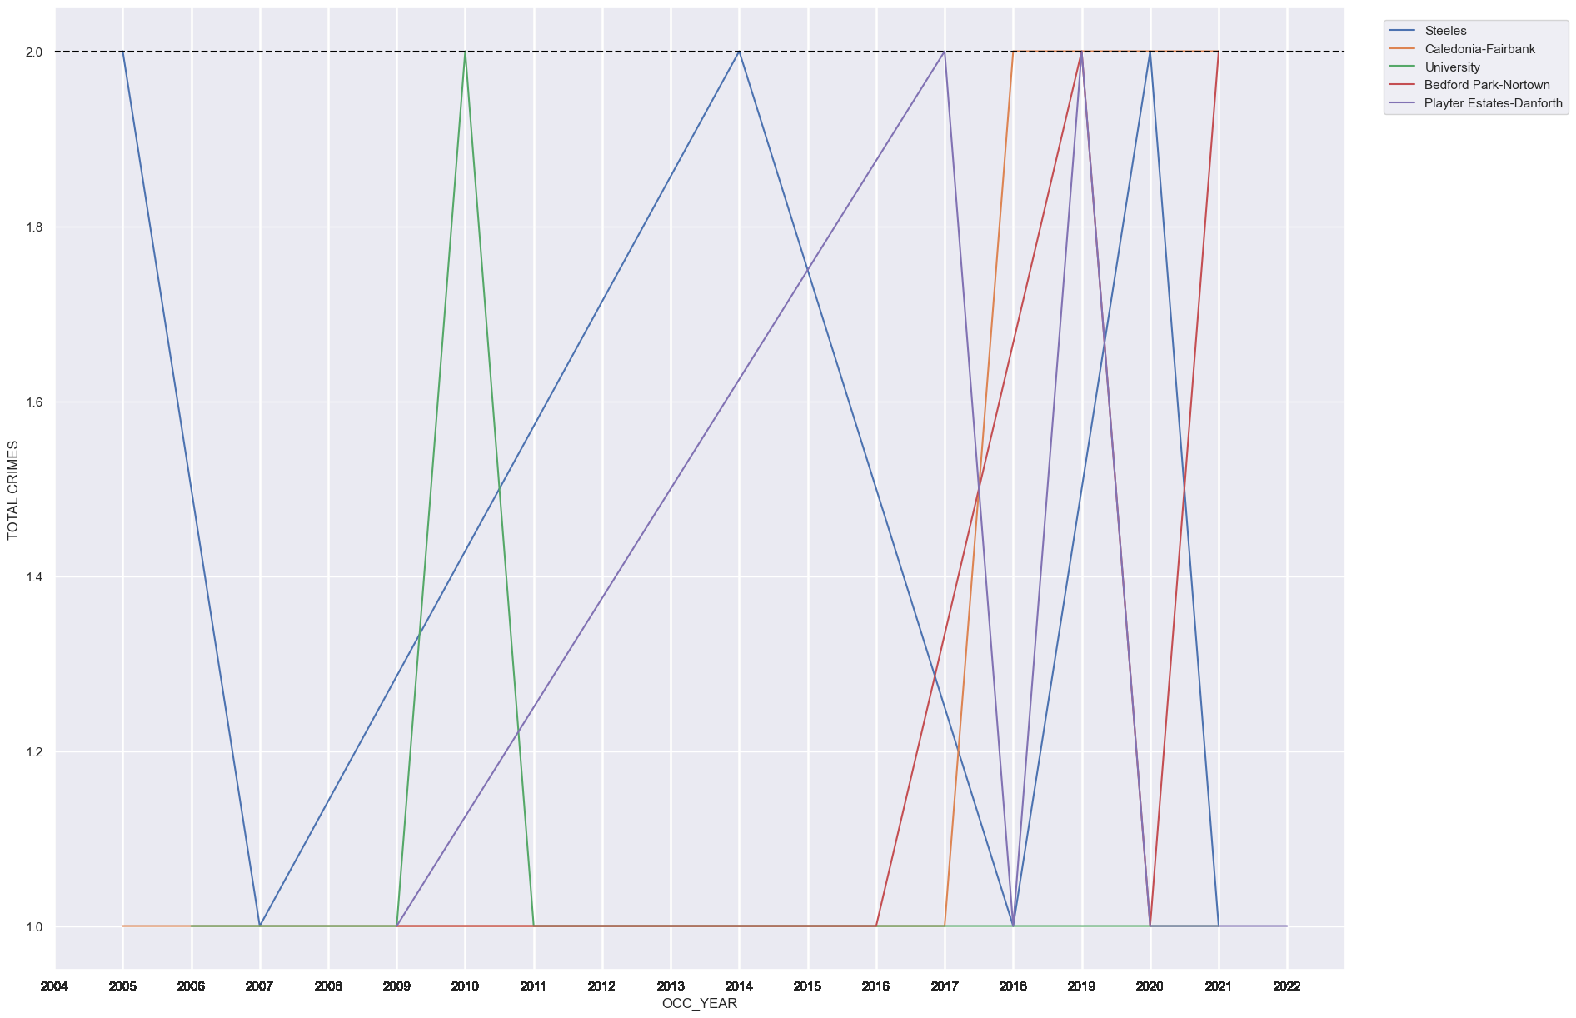
Using visualization techniques we were to able extrapolate and assess high crime and low crime neighborhoods in Toronto
Figure: Plots and trend lines of neighborhoods with high firearm-shooting related crimes in Toronto
Figure: Plots and trend lines of neighborhoods with low firearm-shooting related crimes in Toronto
Key Insights
The plot reveals persistent fluctuations in crime rates of various neighborhoods, consistently positioning them as the neighborhood with the highest occurrence of crime
Over the years, certain neighborhoods in these areas have shown positive signs of decreasing crime rates
Select neighborhoods experience continuous fluctuations in crime rate, oscillating between the highest and lowest crime rates.
In the low-crime neighborhoods, some exhibit remarkable signs of improvement, reflecting positive trends in terms of crime rates.
Notes:
Glenfield-Jane Heights, Black Creek, and Mount Olive stand out with the highest crime rates among the neighborhoods analyzed
Forest Hill South, Lawrence Park North, and Lawrence Park South exhibit the lowest crime rates in the examined areas

Slide 11

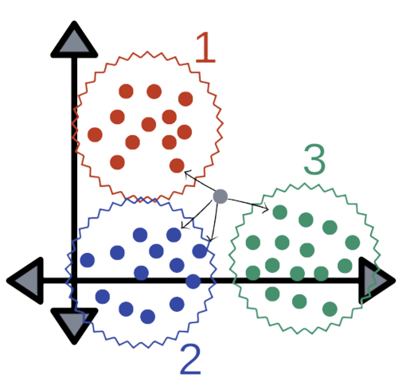
Using historical data we curated a model to predict the area of neighborhood [latitude and longitude] to devise strategies on the best way to re-allocate Toronto police’s resources
To predict the exact location of a potential crime occurrence using latitude and longitude values, the KNN regression model commonly know as KNN regressor was used
KNN Regressor finds K nearest data points, averages target values for predictions
Non-parametric model used to calculate accurate latitude and longitude prediction based on data-geographical relationship.
Approach followed to build the KNN model
Feature Representation
Selecting K value
Predicting Latitude and Longitude
1
2
3
4
5
6
Similarity Measure
Finding K-Nearest Neighbor
Making Proactive Measures

Slide 12
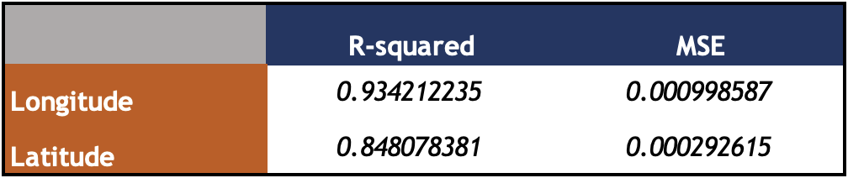

R-squared and MSE values indicate that the model performs well in high crime areas while performs moderately in low crime areas in predicting the location of potential crime occurrences
Figure: Snapshot of R-squared and MSE values for the KNN regression model for high-crime neighborhoods
Figure: Snapshot of R-squared and MSE values for the KNN regression model for low-crime neighborhoods
An R-squared value of 0.93 and 0.84 for longitudes and latitudes indicates that
The model captures a large proportion of the variability in the target variable
Independent variables are doing a good job of explaining the variation in the dependent variable
93% and 84% of the variance respectively in the dependent variable is explained by the independent variables in the model
An R-squared value of 0.59 and 0.47 for longitudes and latitudes indicates that
The model has some level of predictive power but is not able to fully capture all complexities
59% and 47% of the variance respectively shows that the model captures ~half of the variability in predictive values using actual values
Due to lack of diverse data points given a small dataset of low crime neighborhoods the model’s performance is impacted negatively, leading to lower R-squared values

Slide 13
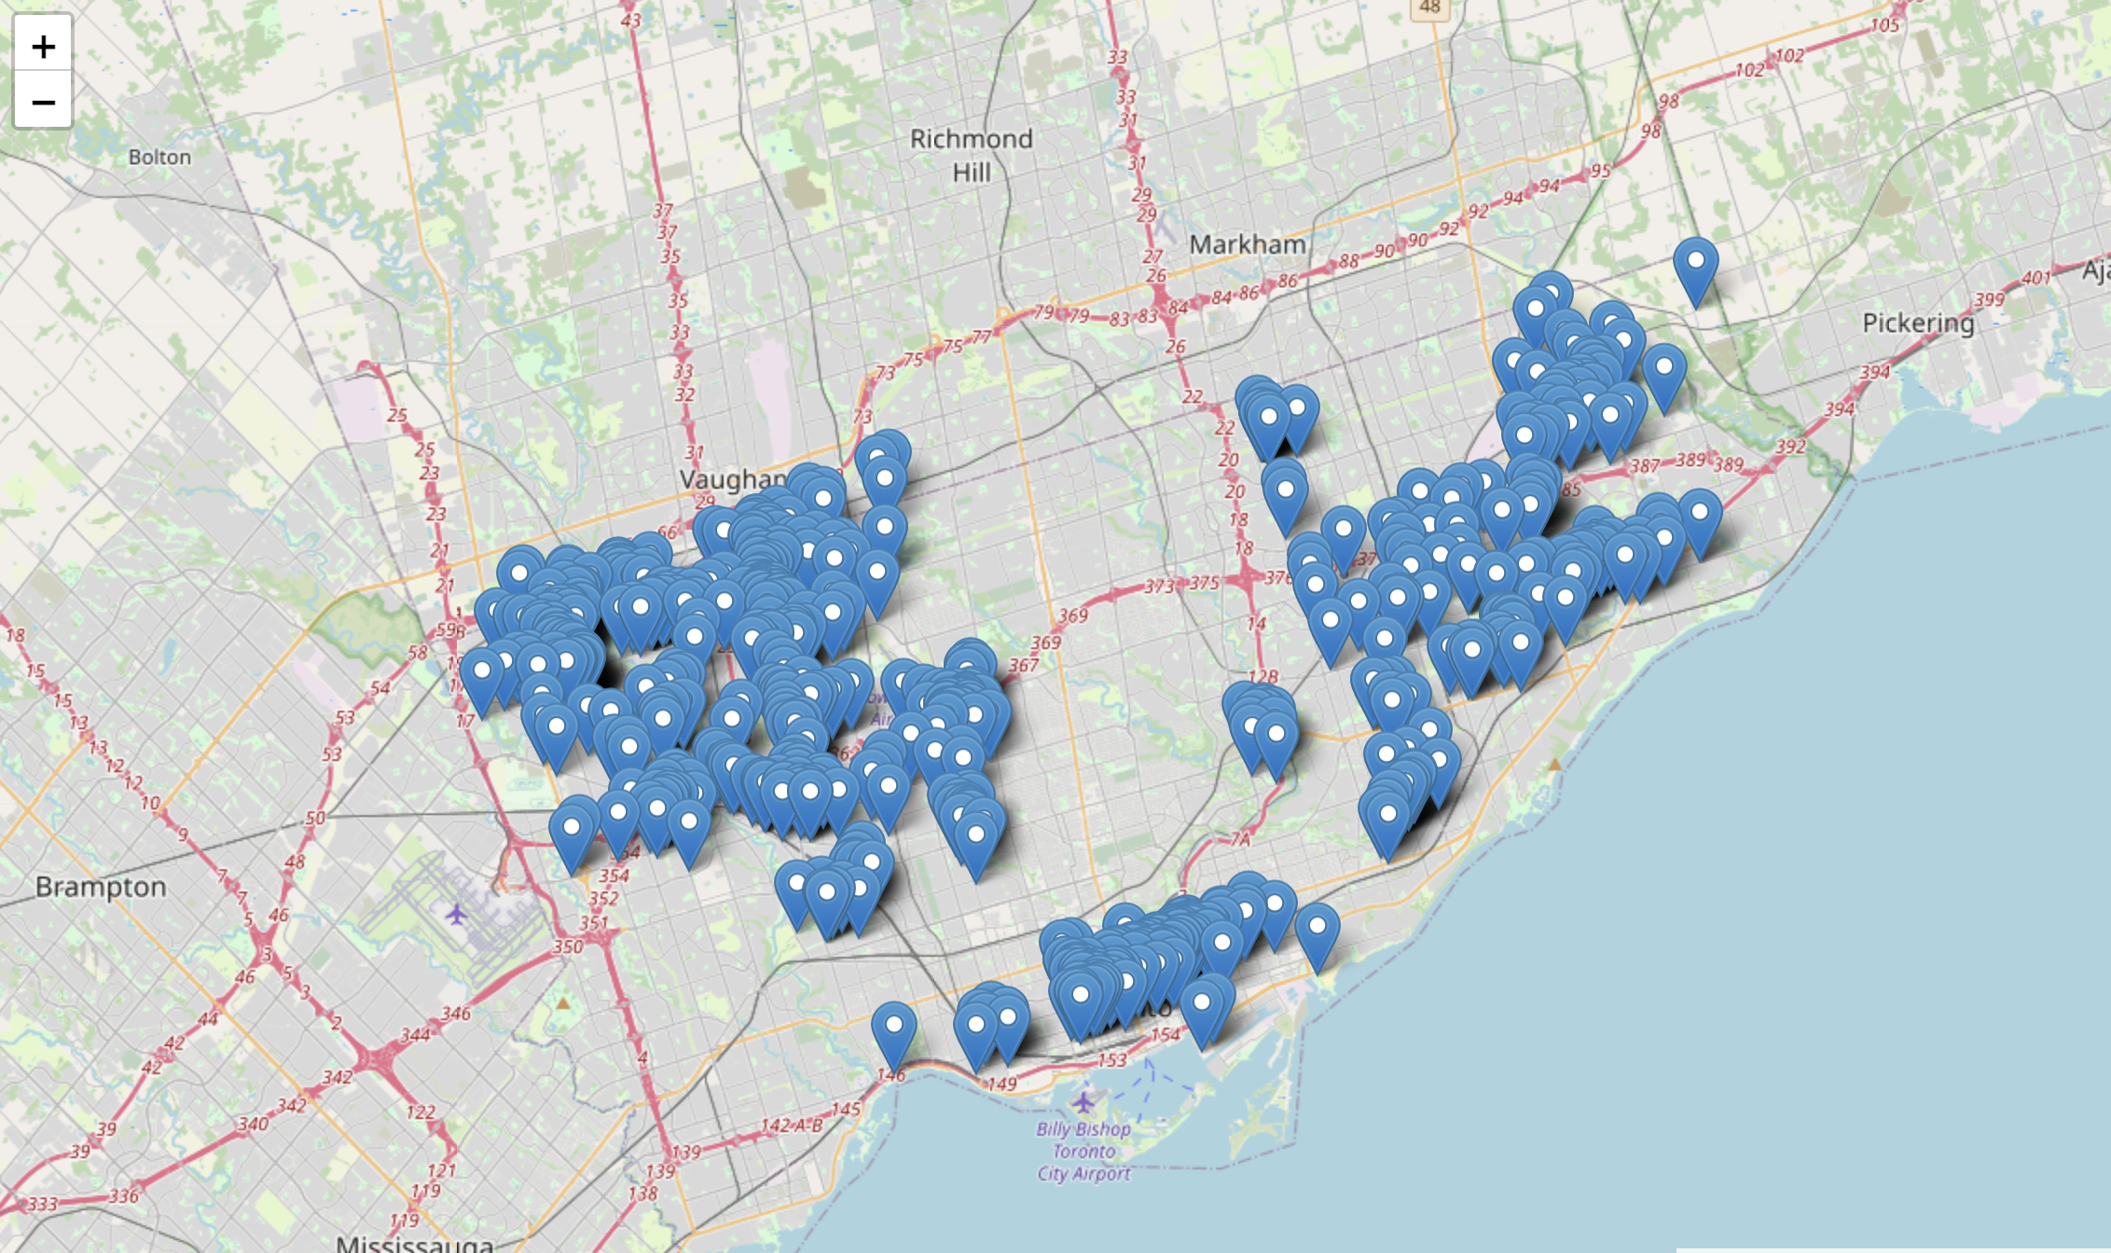
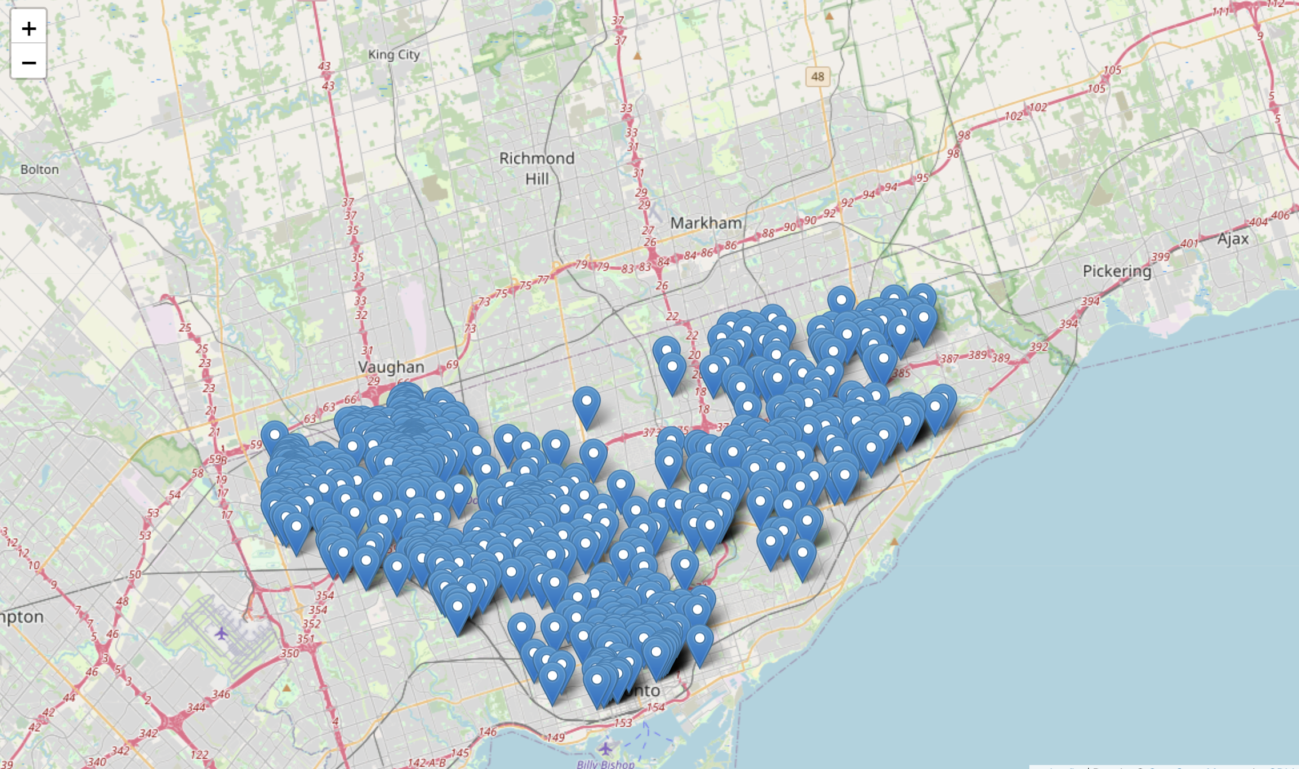

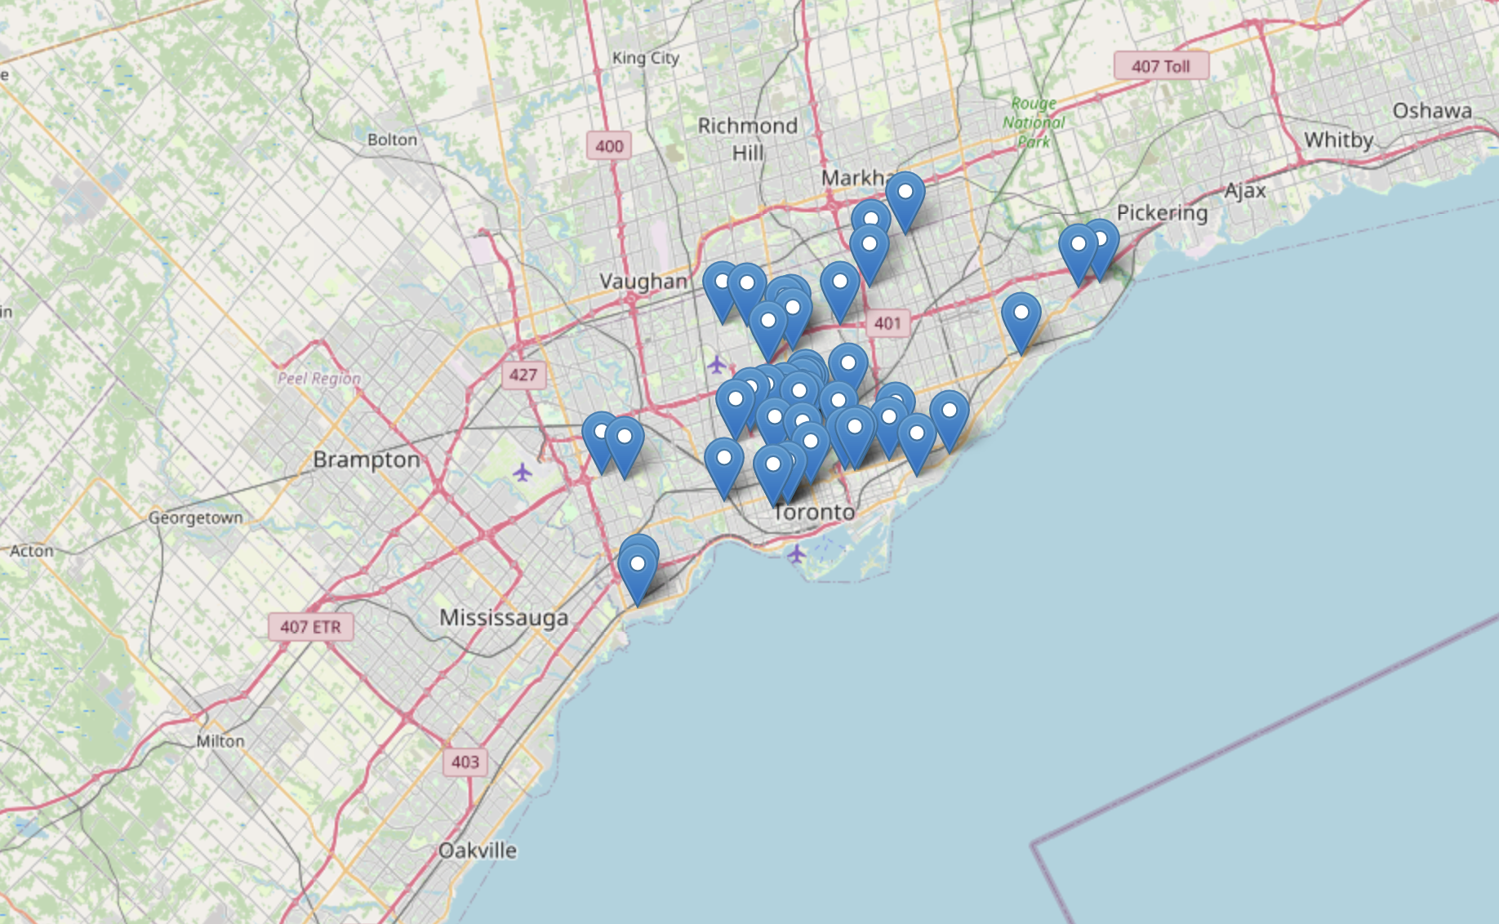
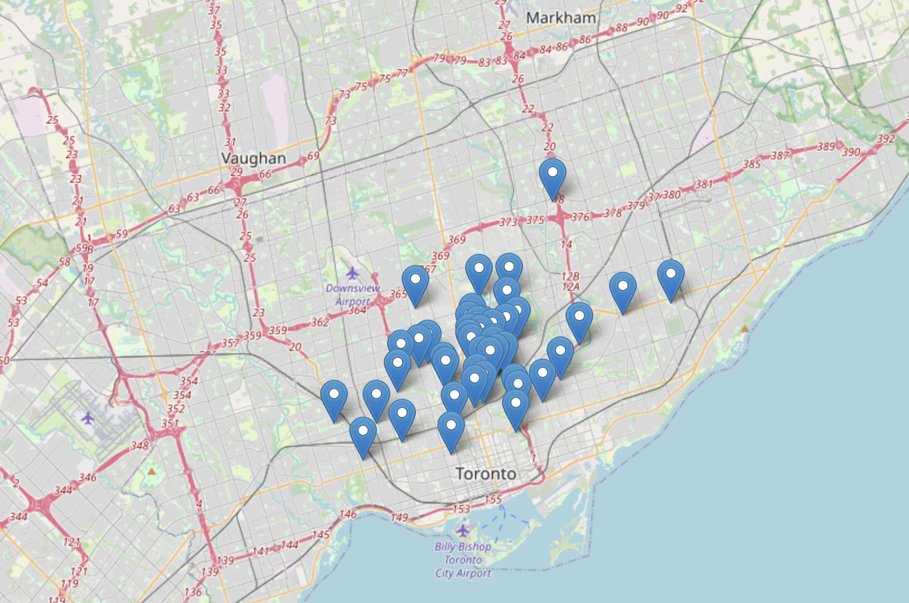

The KNN regression model upon testing indicates its impressive proficiency to predict latitude and longitude values of potential crime locations based on the given historical data
The model demonstrates good ability to fit training data, demonstrates the ability to catch complex patterns, and promises overall improvements in new data
Having higher false positive avoid the chance of missing out such criminal incidents
High Crime Occurring Neighborhoods
Figure: ‘Actual’ latitude and longitude values
Figure: ‘Predicted’ latitude and longitude values
Despite lower crime rate in these neighborhoods and a smaller dataset, the model can predict potential crime occurrences with an accuracy of approximately 60%
Low Crime Occurring Neighborhoods
Figure: ‘Actual’ latitude and longitude values
Figure: ‘Predicted’ latitude and longitude values

Slide 14
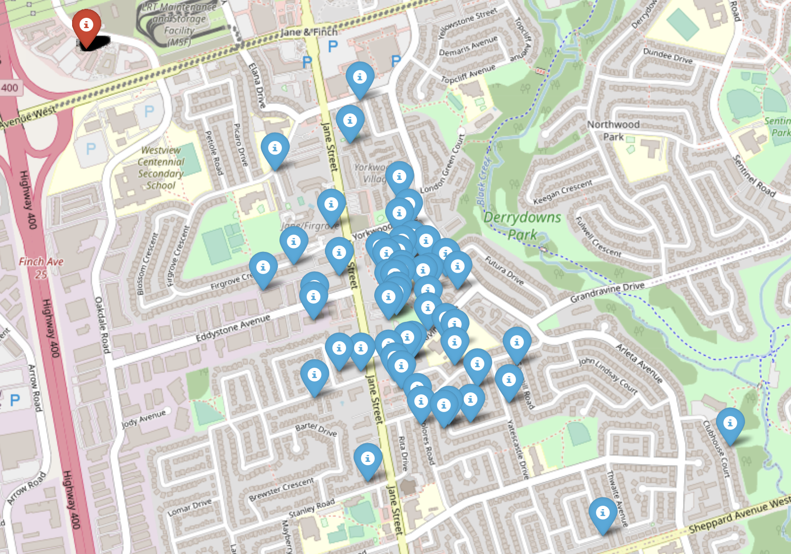
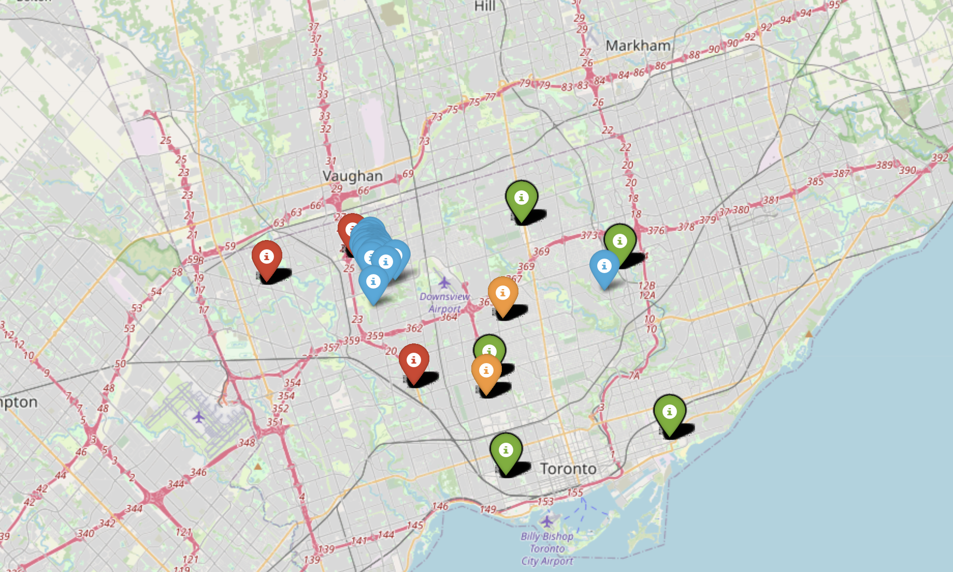
Upon deeper analysis of divisions and crime occurrences in various neighborhoods we can deduce that there is scope to reallocate resources and improve firearm-related crime rate
Currently, crime handled [C1] by a division [D1] which is far from the location and there exists a division [D2] which is much closer – hence opportunity exists to re-allocate personnel and resources
Since location [C3] is a high crime neighborhood and division [D1] can have more resources given division [D2] covers crimes handled by them, resources from [D1] can be allocated to location [C3] to eventually reduce crime rates
D1
C3
C1
Upon zooming in on a high crime neighborhood, need to re-allocate resources arises
D2
C2
Given relatively lesser crimes within this cluster, deploying one police vehicle constantly patrolling the area can reduce crime rates
Higher number of crimes in this cluster as compared to other clusters within this neighborhoods presents a need for allocation of more resources – potentially 2 to 3 patrol vehicles to reduce crime rates
Current division handling crime
Division of low crime neighborhoods
High crime area
Potential division handling crime
Division of high crime neighborhoods
Low crime area

Slide 15
Evaluating stats of external factors such as education and employment helped us assess how fluctuations in these stats across neighborhoods can impact shooting-related crimes
Despite unemployment is a cause of concern for the nation, it does not have any significant impact on shooting related crimes in Toronto based on extrapolated information
Explored external factors suggest possible correlation with criminal incidents, hinting at the likelihood of high shooting related crime
Evidently, the education rate in high-crime neighborhoods is below the Toronto City average
Unemployment rates in these area is also relatively lower compared to other areas, leading to plausibility of higher crime rates
Higher education rate as compared to high crime neighborhoods indicate the lesser crime occurrences in these areas
Relatively higher education rate in these neighborhoods when compared to Toronto city average
Lower unemployment rate as compared to Toronto city average even within these area
Low education (and employment) rates in certain neighborhoods, which lead to a high shooting related crimes in such areas, presents a need to invest in literacy and generate employment

Slide 16
Agenda
Key Research Objectives
Executive Summary
Introduction
Analysis and Modelling
Recommendations and conclusions
Next Steps

Slide 17



Recommendations and Conclusions
Re-organize
Move and relocate resources and police personnel to enhance convenience, save on costs and proficiently handle crime-related incidents in areas of greater need, in this case high crime neighborhoods
Re-allocate
Implement a need-based distribution of resources such as police personnel and patrol cards, especially in high crime areas where multiple different clusters of criminal incidents exist to effectively mitigate such activities and drive citizen comfort
Re-invest
Devise strategies and collaborate with city council and concerned authorities to initiate school outreach and after school programs that not only focus on academic curriculum but also promote gun safety and anti-violence campaigns
Although not a big factor, reduce unemployment and any crime rising from that by carrying out initiatives and reaching out to suitable authorities to generate employment

Slide 18
Agenda
Key Research Objectives
Executive Summary
Introduction
Analysis and Modelling
Recommendations and conclusions
Next Steps

Slide 19
Next Steps
3
Once our model has reached its full potential, it can then be used in other cities and regions within the country. This will help the governmental agencies to make data-driven decisions in allocating resources and potentially reducing heinous crimes across the country resulting in safer and happier society
2
Our model has the potential to extend its application to predicting various crimes, including homicides. It utilizes reproducible features such as Month, Day, and Time range to generate accurate predictions. Furthermore, it can adapt to different databases with similar characteristics, making it versatile in its applicability.
1
While our model shows high accuracy in predicting crime in high-crime neighborhoods, there is room for improvement in its predictability for low-crime neighborhoods

Slide 20
References
Allen, M. (2022, May 27). Trends in firearm-related violent crime in Canada, 2009 to 2020. Statistique Canada. Retrieved June 2, 2023, from https://www150.statcan.gc.ca/n1/pub/85-002-x/2022001/article/00009-eng.htm
Andresen, M. A. (2012, 11 6). Unemployment and crime: A neighborhood level panel data approach. https://www.sciencedirect.com/science/article/pii/S0049089X12001548
B, W. (2019, June 21). Danforth shooter had “extensive history of mental illness” but no clear motive: Toronto police. Durham Radio News. Retrieved June 2, 2023, from https://www.durhamradionews.com/archives/119781
Boyce, J. (2015, November 30). Police-reported crime statistics in Canada, 2014. Statistique Canada. Retrieved June 2, 2023, from https://www150.statcan.gc.ca/n1/pub/85-002-x/2015001/article/14211-eng.htm
Hopper, T. (2023, April 13). Canada is seeing violent crime like never before. What's behind the wave of killings and attacks. National Post. Retrieved June 2, 2023, from https://nationalpost.com/news/canada/canadas-violent-crime-wave
Kim1, D. Y. (2010, 5 3). The Impact of COVID-19 on Gun Violence Across Census Tracts in NYC. https://journals.sagepub.com/doi/pdf/10.1177/10887679221077036
Moselle, A. (2021, July 7). Study shows correlation between jobs and gun violence. WHYY. Retrieved June 2, 2023, from https://whyy.org/articles/philly-study-shows-strong-correlation-between-unemployment-and-gun-violence/
Ngabo, G. (2021, December 30). Toronto records third-deadliest year in almost two decades. The Toronto Star. Retrieved June 2, 2023, from https://www.thestar.com/news/gta/2021/12/29/mental-health-gun-violence-factors-in-torontos-second-deadliest-year-in-over-a-decade.html
Schleimer, J. P. (2022, January 27). Unemployment and Crime in US Cities During the Coronavirus Pandemic. https://link.springer.com/article/10.1007/s11524-021-00605-3
STAFF, T. (2022, February 1). Report Links Unemployment with Rise in Gun Crime During Pandemic. The Crime Report. Retrieved June 2, 2023, from https://thecrimereport.org/2022/02/01/report-links-unemployment-with-rise-in-gun-crime-during-pandemic/

Slide 21
Appendix
Link to analysis and synthesis file, also attached in speaker notes
Notes:
https://github.com/mahinbindra/schulich_data_science/blob/main/MMAI%205000/Group%2010_MMAI%20Project%20Notebook_v1.0.ipynb

